Slide 1

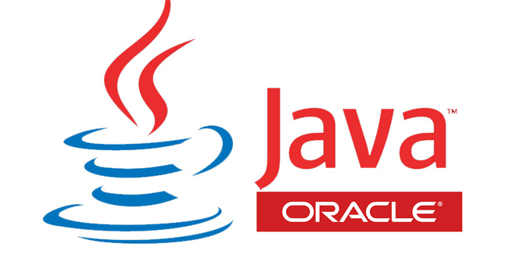
Wprowadzenie do platformy JAVA 1. JAVA as a language
Hello world!
My name is Duke.
I’m JAVA mascot

Slide 2
Adam Mika
Java developer
sda.adam.mika@gmail.com
Dropbox: javakrk1@gmail.com
Github?
Source of pictures used for educational purposes:
my private
JAVA documentation / ORACLE pages
Wikipedia
google image search

Slide 3
Agenda
Language vs formal language
what is it?
Grammar categories – Chomsky hierarchy
why do we need programming language?
BNF notation
How to define programing language?
Compilation – high and low level
How to change “words” into working program/process?
Programming languages classification
What options do we have?
JAVA language specification
Language specification + JAVA language properties
Exercises

Slide 4
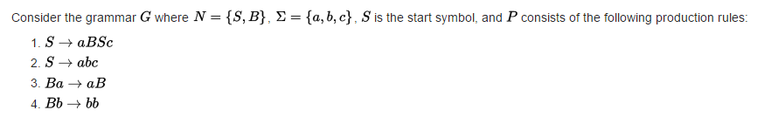
Language vs formal language
Alphabet (∑) = set of symbols
Language (L) = set of finite-length sequences of symbols from its alphabet
Formal language = language + grammar (syntax):
G = grammar, N – non-terminal symbols (replaceable), ∑ - terminal symbols (non-replaceable), P – production rules

Slide 5
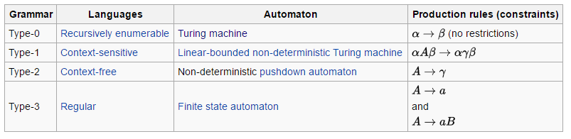
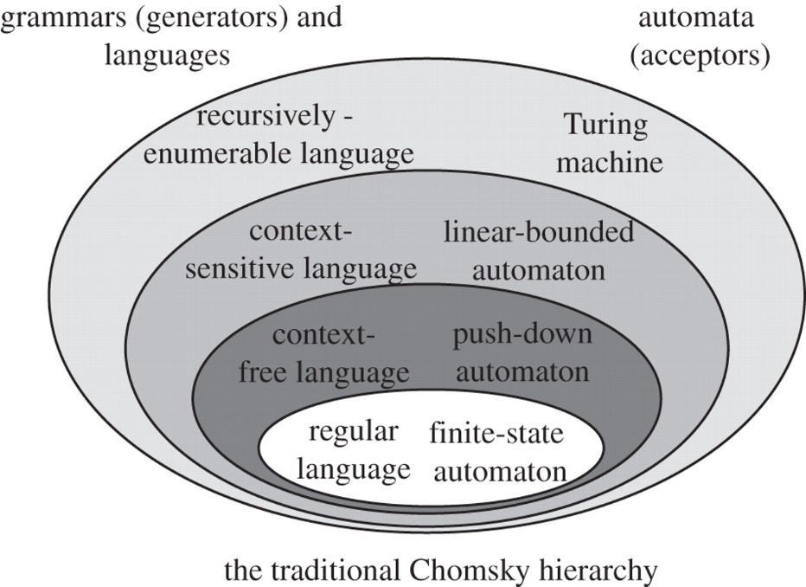
Chomsky hierarchy – grammar classification
A, B – non-terminal symbols
a – terminal symbol
α, β, γ – terminal or non-terminal
Type-0 = structured language
Type-1 ~ natural language
Type-2 ~ programming language
Type-3 ~ pattern definition (regexp = regular expressions)

Slide 6
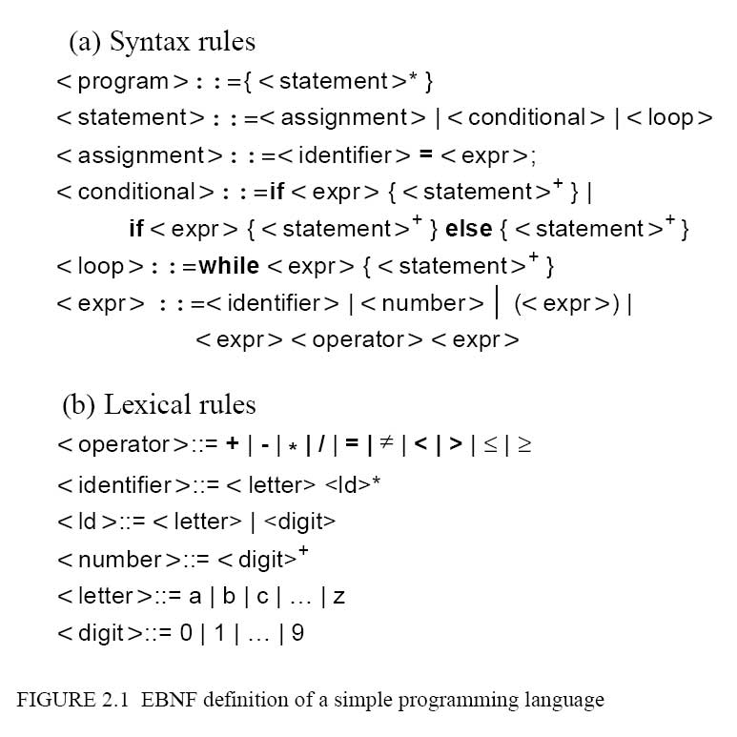
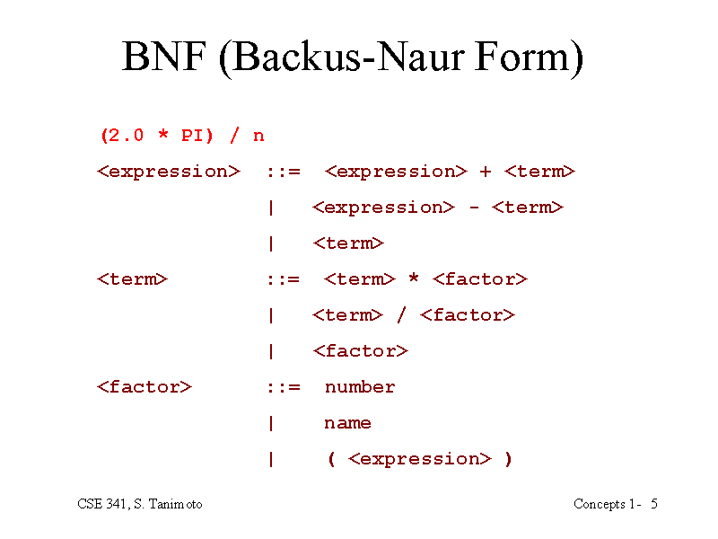
How to represent grammar?

Slide 7

- concept of context-free language
how to specify programing language syntax
Terms: formal language, terminal/non-terminal symbol, regexp, lexical rule, syntax rule

Slide 8
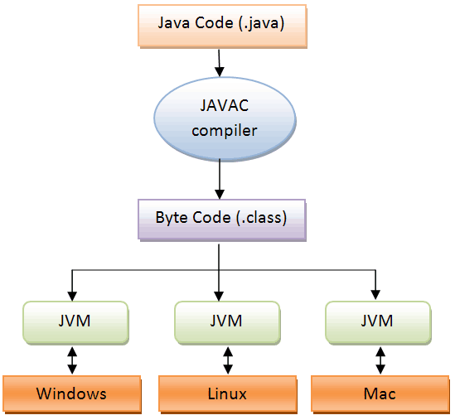
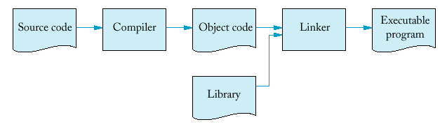
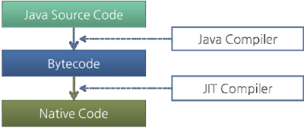
Compilation – high level How to change language into process?

Slide 9
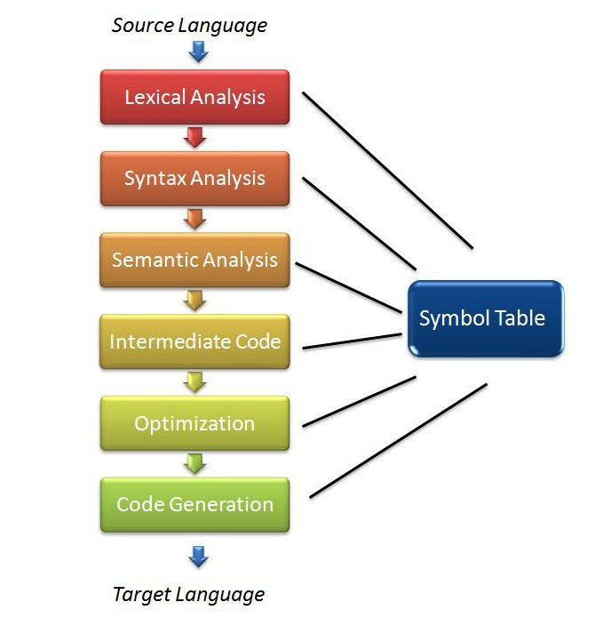
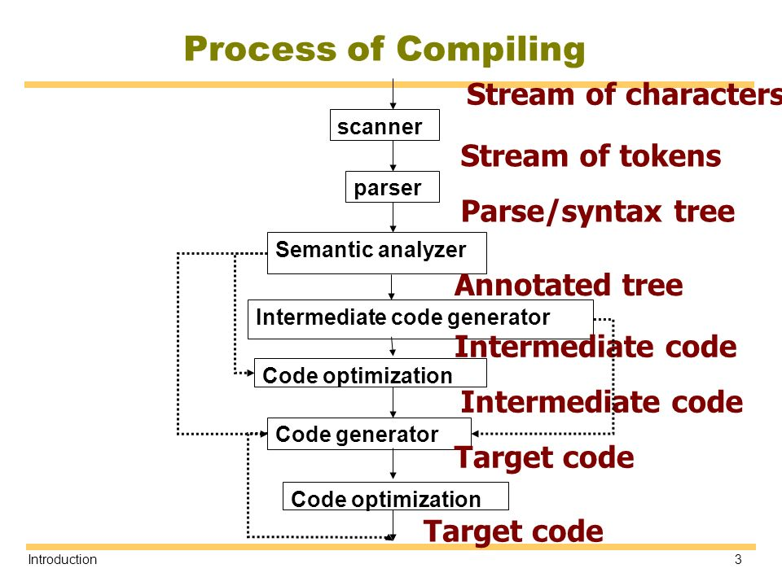
Compilation – low level

Slide 10
- steps from source code to native code (machine dependent)
Terms: lexer/scanner, token, parser, Abstract Syntax Tree (AST) compiler, optimizer, intermediate code, java byte code

Slide 11
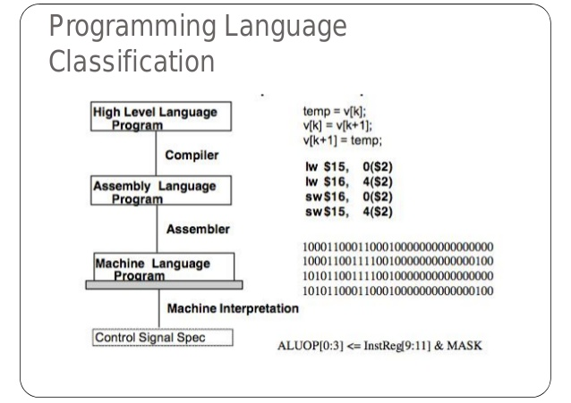
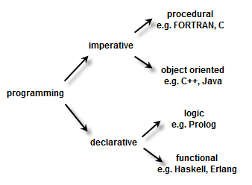
Programming languages classification

Slide 12
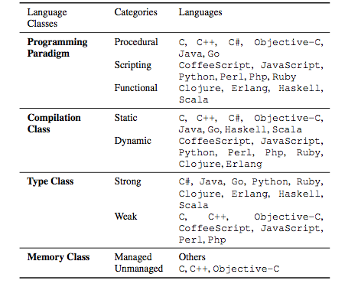
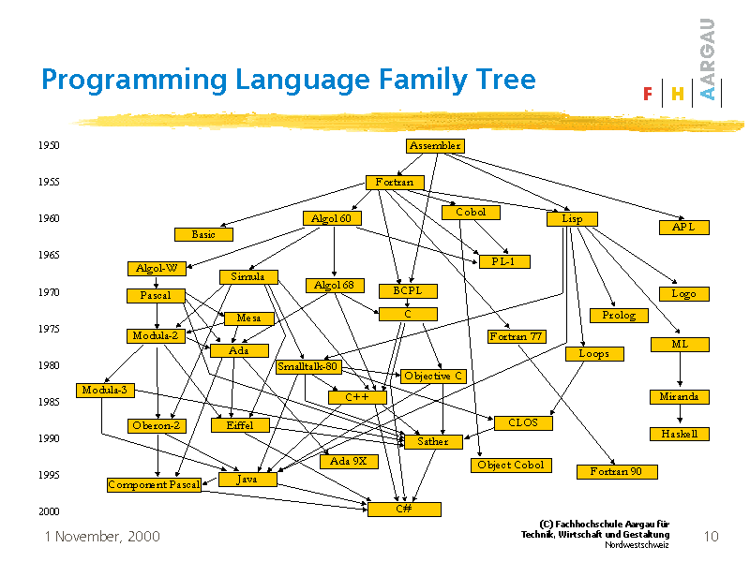
Programming languages classification

Slide 13
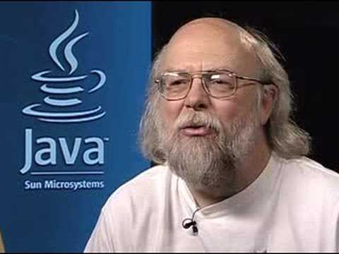

JAVA language (23 January 1996) James Gosling, Sun Microsystems
JAVA language != Java Script language
context-free
high-level (3G = 3rd generation)
imperative
object-oriented (concept of class, attributes, methods)
static compilation: from java language to java byte code
dynamic compilation: from byte code to native code (JIT compiler)
strongly typed (types correctness checked during compilation)
managed memory (GC – garbage collector, automatic memory reclaim)

Slide 14
- Main properties of java language
Terms: strongly-typed language, JIT, GC, object-oriented language, imperative language, declarative language

Slide 15
Exercise 0
Open webpage: https://docs.oracle.com/javase/specs/
Open specification of JAVA8 language and find syntax for “Integer Literals”.
Using lexical-rules specified for this non-terminal represent number 15 in 10 different ways as literal in java source code.
Open java virtual machine specification and read about java byte code instruction “aconst_null”
Open page: https://jcp.org/en/jsr/all . What is JSR?
Open page: http://www.oracle.com/technetwork/java/javase/archive-139210.html
Choose Java SE(Standard Edition) 8 and have a quick look at available installation packs.

Slide 16
Exercise 1
Download JAVA 8 JDK (Java Development Kit)
Open console (cmd), execute in console javac
In next step execute javac – version.
Write simple java program and save it in .txt file
Compile created file using static compiler javac. Observe result.
Change file extension to .java and compile again. Observe result.
Open generated .class file in simple text edition (notepad++)
Compile again .java file with option –verbose. Analyze compilation steps.
Decompile .class file to see java byte code javap -c Hello.class
Check semantic for instruction of your wish in JVM specification

Slide 17
Exercise 2
Create very simple “Hello World” java source code and save it in Hello.java
Add to the source code package declaration “com.test”
Compile using javac Hello.java and next execute:
java Hello
java com.test.Hello
java Hello.class
java com.test.Hello.class
What happened?
Compile using javac –d . Hello.java
What’s the difference?
Try to execute all variants from previous step.
How to run such class file?
cd (change directory command) to ./com/test and try to run .class file.
What is your observation?

Slide 18
Homework
Find information how to interpretation java version output in the Internet.
Compare formal language specification with user documentation (section “Integer Literals”)
https://docs.oracle.com/javase/tutorial/java/nutsandbolts/datatypes.html
Run “Hello World” with –splash option. What is splash?
Rename Hello.java (containing public class Hello) file to hello.java
Compile using: javac –d . Hello.java
Compile using: javac –d . hello.java
Update source file - change class name to public class hello
Check both commands from previous point.
What can you tell about java file/class naming convention?
Find in the Internet information about: ANTLR - ANother Tool for Language Recognition and try to understand very basic examples and/or run it on your own.

